Slide 1


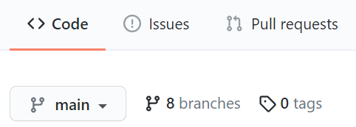








The epidemiologist’s “two-way table” of Github ☺
MAIN BRANCH
OTHER BRANCHES
MAIN BRANCH (remote)
This is the final, primary, “live” version of your files
PULL REQUEST
Review, approval, then merge
OTHER BRANCHES (remote)
Only reflects changes pushed up from local computers.
Submit a pull request to merge this branch into main branch, which will incorporate the changes
REMOTE on github.com
View branches in github.com
Push and pull to sync the online and remote versions of the branch
PUSH
PULL
PUSH
PULL
LOCAL on
your computer
MAIN BRANCH (local)
Open locally in RStudio and pull to refresh changes made by other collaborators
Create a new branch to work in with this button:
You can directly edit main branch files, saving commits and pushing them directly to remote… but you must have correct permissions, and this will bypass review.
CREATE NEW BRANCH
(pull main first!)
OTHER BRANCHES (local)
Create or switch from main to other branches.
Pull to refresh changes made by others collaborating on this branch.
Edit files in RStudio. Save changes and commit them.
Pushed commits will be reflected in the REMOTE version of this branch.
File changes are grouped into “commits”, which are pushed up to Github or pulled down to the computer
Select/create local branch in RStudio
Made by Neale Batra, April 2021

Slide 2
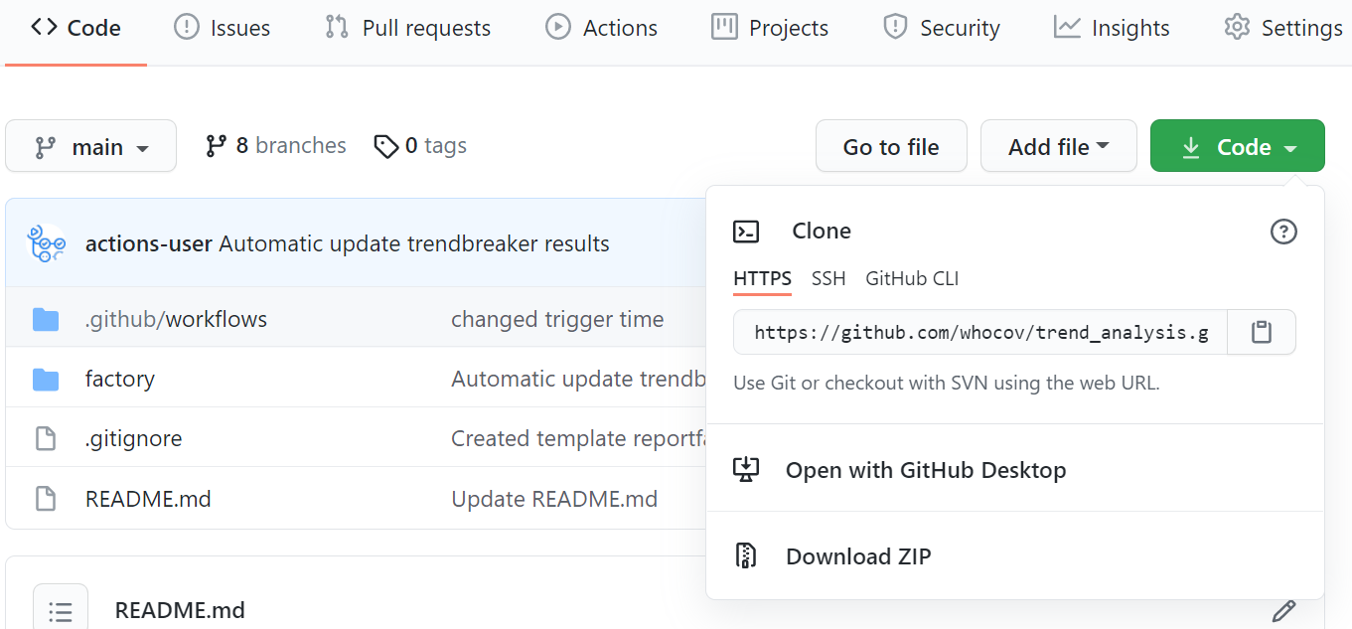





Slide 3
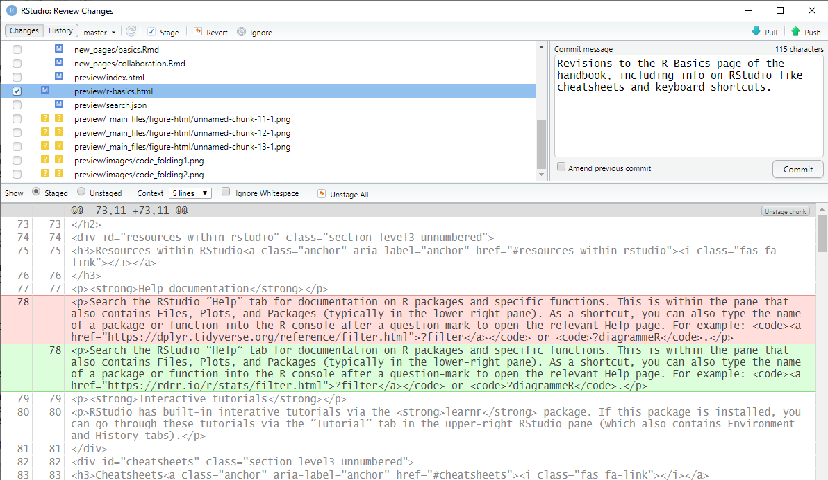
Instead of staging, you can revert a file back to it’s original state (to the last commit)
The RStudio “Commit” window
“Stage” a file’s changes by checking it’s adjacent box
You can stage multiple files per commit by highlighting the lines and clicking the “Stage” button
Write a short commit message describing what you did. It’s a message to your team/future self
Press “commit” to commit the changes
See what you
deleted (red) and added (green) in the file

Slide 4
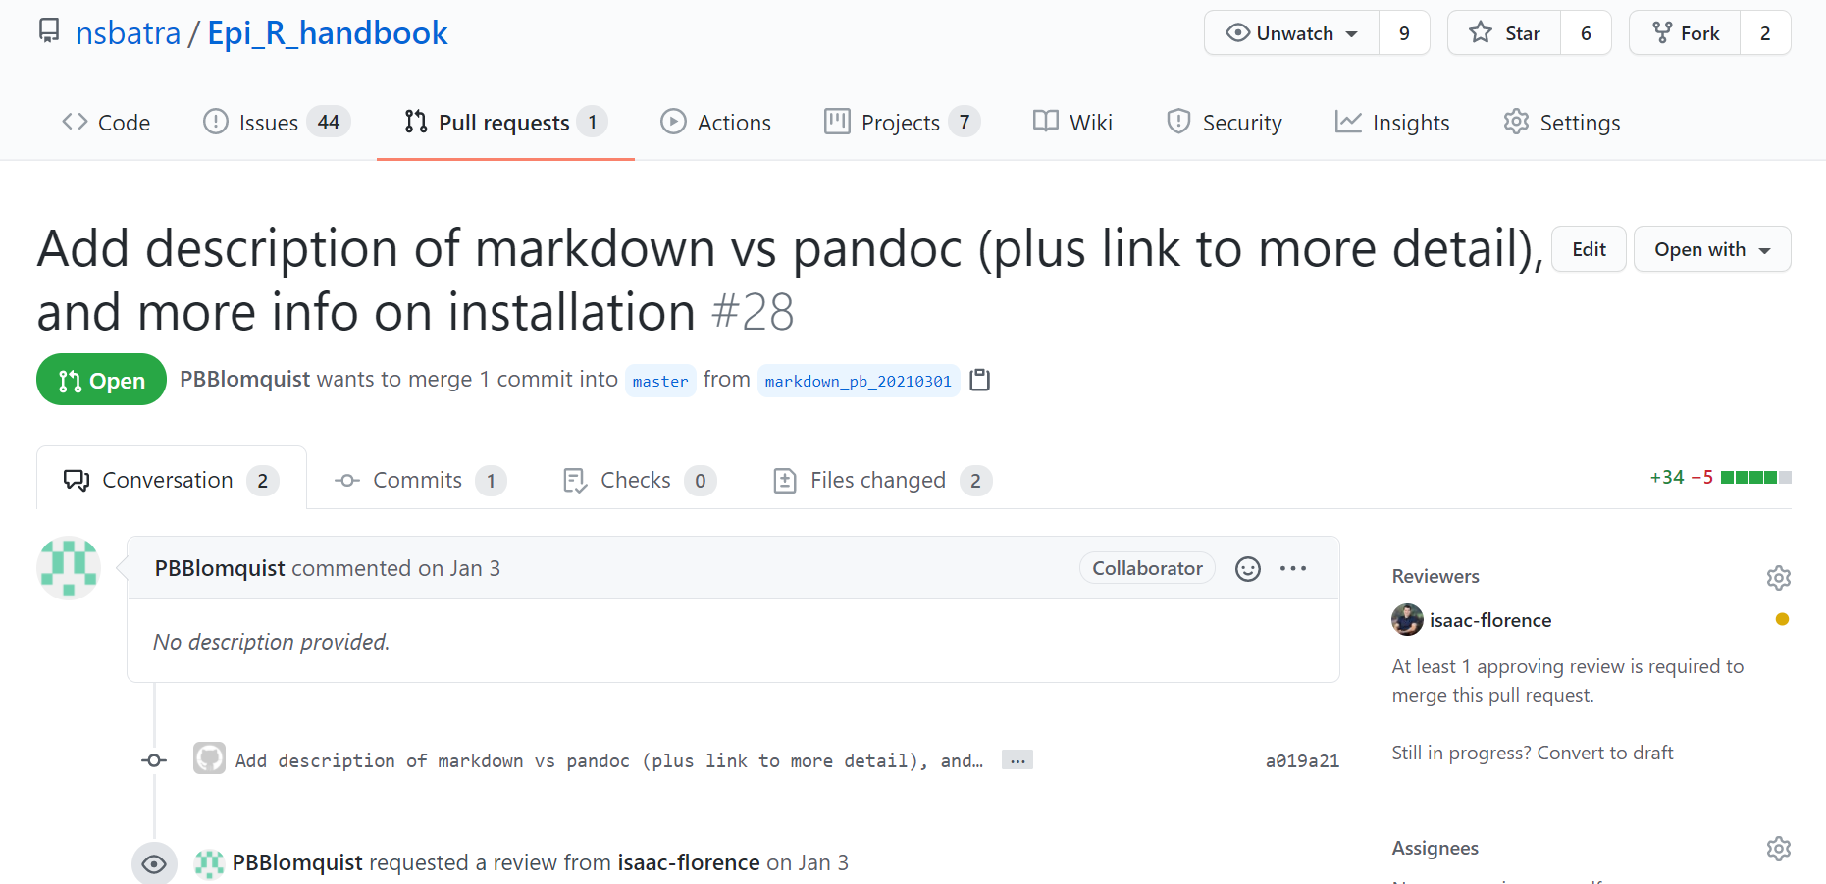
An example pull request
This pull request contains 1 commit
Description of pull request
Have a conversation by posting below
Request reviewers with the gear symbol
Review and comment on the line-by-line changes

